Slide 1
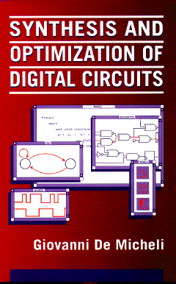


Multi-level Logic Synthesis
Giovanni De Micheli
Integrated Systems Laboratory
This presentation can be used for non-commercial purposes as long as this note and the copyright footers are not removed
© Giovanni De Micheli – All rights reserved

Slide 2
Module 1
Objectives
  What is multi-level logic synthesis
  What are the specific goals
  Stepwise transformations

Slide 3
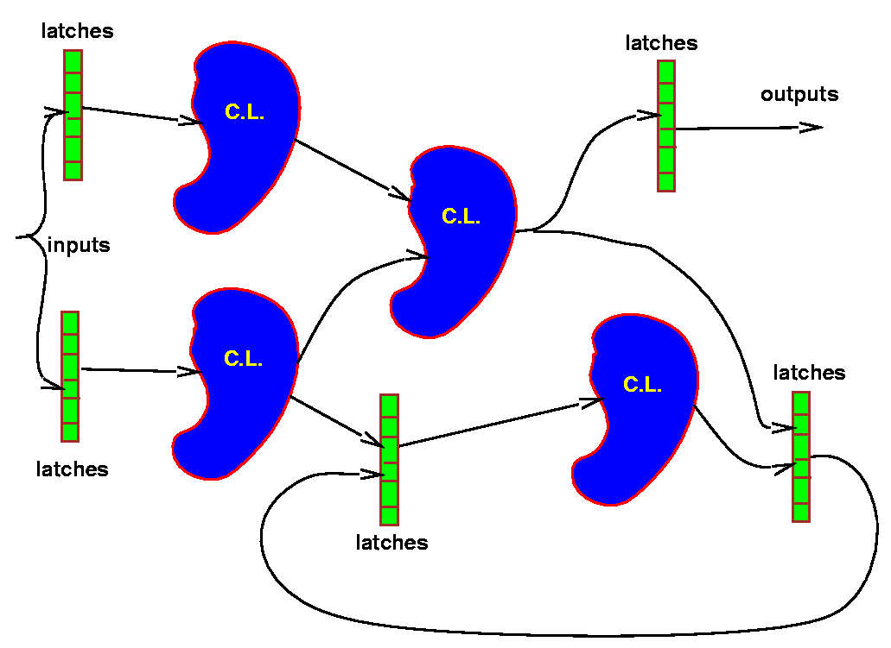
Motivation
Multiple-level logic networks
  Semi-custom libraries
  Logic gates versus macro-cells
    More flexibility
    Privilege specific paths on others
    Better performance
Applicable to a large variety of designs
The importance of logic synthesis grew in parallel with the growth of foundries for the semi custom market
Notes:
Combinational logic circuits are very often implemented as multiple-level networks of logic gates.
The fine granularity of multiple-level networks provides us with several degrees of freedom in logic design, that may be exploited in optimizing area and delay as well as in satisfying specific constraints, such as different timing requirements on different input/output paths.
Thus multiple-level networks are very often preferred to two-level logic implementations, such as PLAs.

Slide 4
Circuit model
Logic network
  An interconnection of blocks
    Each block modeled by a Boolean function
  Usual restrictions:
    Acyclic and memoryless
    Single-output functions
The model has a structural/behavioral semantics
  The structure is induced by the interconnection
Mapped network
  Special case when the blocks correspond to library elements
Notes:
We consider multiple-level circuits that are interconnections of single-output combinational logic gates. We assume that the interconnection provides an unidirectional flow of signals from a set of primary inputs to a set of primary outputs.
A consequence of the unidirectionality is the lack of feedbacks and thus the overall circuit implements strictly combinational functions.
The abstract model for these multiple-level logic circuits is called logic network, and it is a hybrid behavioral/structural model.
In the particular case that the network is bound (mapped) to a library, the model has just a structural semantics.

Slide 5
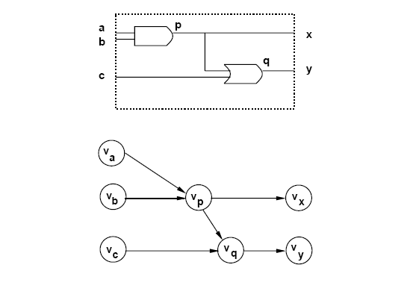
Example of mapped network
Notes:
This simple example shows the interconnection of 2 logic gates, and its abstraction as a network graph.

Slide 6
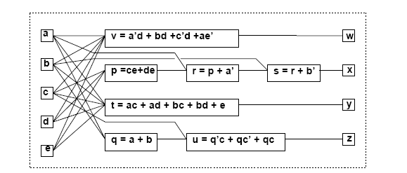
Example of general network
Notes:
This example shows a logic network, i.e. an interconnection of logic blocks, associated with logic functions.

Slide 7
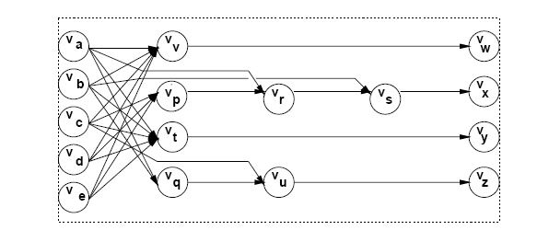
Example of general network graph
Notes:
This is the graph abstraction of a logic network.

Slide 8
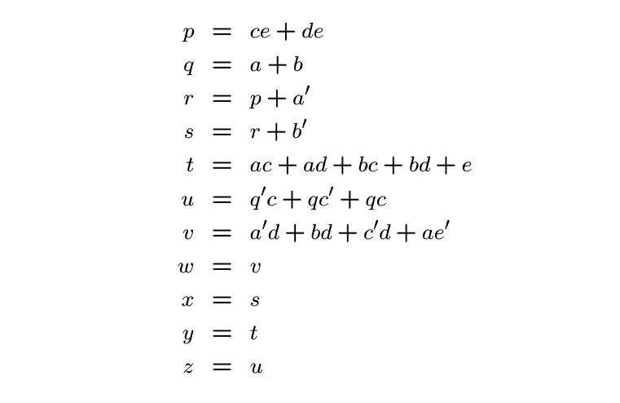
Network represented by assignments
Notes:
This is the expression (language) model of a logic network.

Slide 9
Example of terminal behavior
I/O functional behavior
  Vector with as many entries as primary outputs
  Each entry is a logic function
  a’d + bd + c’d + ae’
  a’ + b’ + ce + de
  ac + ad + bc + bd + e
  a + b + c
f =
Notes:
A circuit behavior may be mapped into many equivalent structures.
Conversely, a unique behavior of a combinational circuit can be derived from its structure.
The behavior can be represented by a vector of logic functions, one per output of the logic network.

Slide 10
Network optimization
Minimize maximum delay
  (Subject to area or power constraints)
Minimize area
  Subject to delay constraints
Minimize power consumption
  Subject to timing constraints
Notes:
There are several objectives in logic optimization, namely:
Delay minimization (frequency maximization)
Area recovery subject to timing constraints
Power recovery subject to timing constraints

Slide 11
Estimation
Area:
  Number of literals
    Easy, widely accepted, good estimator
Delay:
  Number of stages (under fanout constraint?)
  Gate delay models with wire-loads
  Sensitizable paths
Power
  Switching activity at each node
  Capacitive loads
Notes:
A common way to estimate the area is to relate it to the number of literals of a factored form representation of the functions.
The rationale is based on the fact that a cell generator for the virtual gate in MOS technology would require as many polysilicon stripes as the number of literals (plus possibly one for the gate output).If all cells have the same height, and their width is roughly proportional to the number of polysilicon stripes, then the gate area is proportional to the number of literals. The total number of literals in a network relates then to the overall gate area.
Delay modeling is important in computing accurately the path delays and it involves two issues: the computation of the propagation delay associated with each vertex and the path delay computation. The propagation delay associated with a vertex can be easily estimated for bound networks, because the gate delay as a function of the fanout is provided with the library specification. Otherwise, the propagation delay must be estimated for a virtual gate implementing the local function.
A crude model is to assume unit delay per stage. More refined models involve relating the propagation delay to the complexity of the logic function and its fanout.
Power consumption depends on the switching activity at each node, as well as on its local capacitance. Power models require some assumptions on the environment (i.e., input activity).

Slide 12
Problem analysis
Even the simplest problems are computationally hard
  E.g., multi-input single-output network
Few exact methods proposed
  High complexity
  Practical for small circuits only, but… useful!
Approximate optimization methods
  Heuristic algorithms
  Rule-based methods
Notes:
Logic synthesis and optimization is intrinsically complex.
There have been a few exact methods that have been proposed, and they have been shown to be impractical.
Engineers use approximation methods based on heuristic algorithms or rule-based systems.

Slide 13
Strategies for optimization
Improve network step by step
  Circuit transformations
Preserve network I/O behavior
  Exploit environment don’t cares if desired
Methods differ in:
  Types of transformations applied
  Selection and order of the transformations
Notes:
Heuristic methods for multiple-level logic optimization perform a stepwise improvement of the network by means of logic transformations, that preserve the input/output network behavior.
Fortunately, most logic transformations are defined so that network equivalence is guaranteed and does not need to be checked. Application of logic transformations in any sequence preserves then network equivalence.

Slide 14
Elimination
Eliminate one function from the network
  Similar to Gaussian elimination
Perform variable substitution
Example:
  s = r + b’; r = p + a’;
  s = p + a’ + b’;
Notes:
The elimination of an internal vertex is its removal from the network.
The variable corresponding to the vertex is replaced by the corresponding expression in all its occurrences in the logic network.

Slide 15
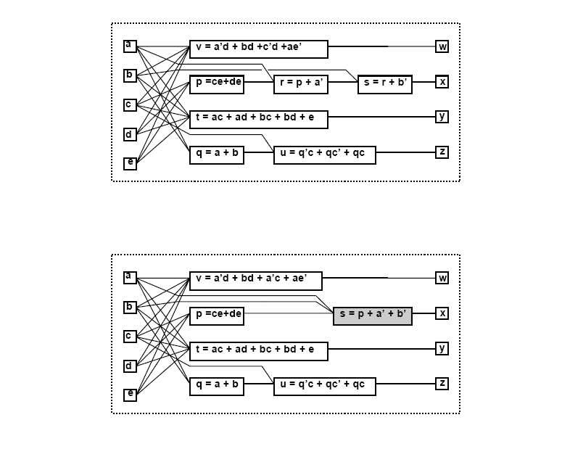
Example
Notes:
Network before and after elimination.

Slide 16
Decomposition
Break a function into smaller ones
  Opposite to elimination
Introduce new variables/blocks into the network
Example:
  v = a’d + bd +c’d +ae’
  j = a’ + b + c’; v = jd + ae’;
Notes:
The decomposition of an internal vertex is its replacement by two (or more) vertices,
that form a subnetwork equivalent to the original vertex.

Slide 17
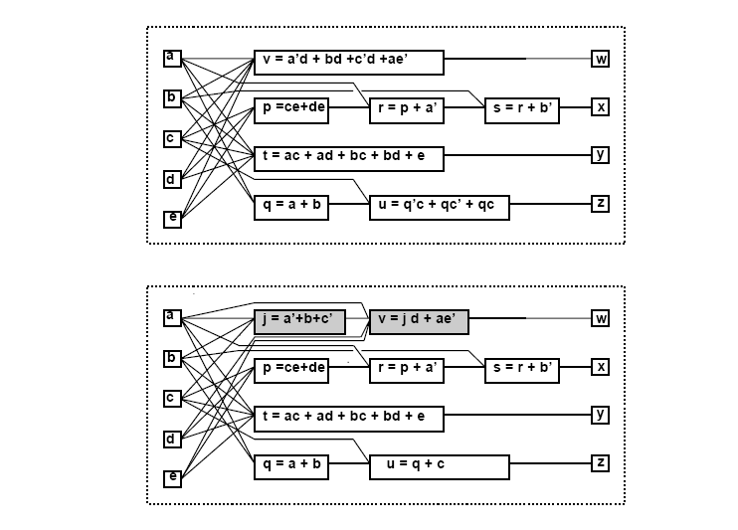
Example
Notes:
Example before and after decomposition.

Slide 18
Extraction
Find a common sub-expression of two (or more) expressions
  Extract new sub-expression as new function
  Introduce new block into the circuit
Example
  p = ce + de; t = ac + ad + bc + bd + e;
  p = ( c + d ) e; t = ( c + d ) ( a + b ) + e;
  k = c + d; p = ke; t = ka + kb + e;
Notes:
A common sub-expression of two functions associated with two vertices can be extracted, by creating a new vertex associated with the sub-expression.
The variable associated with the new vertex allows us to simplify the representations of the two functions by replacing the common sub-expressions.

Slide 19
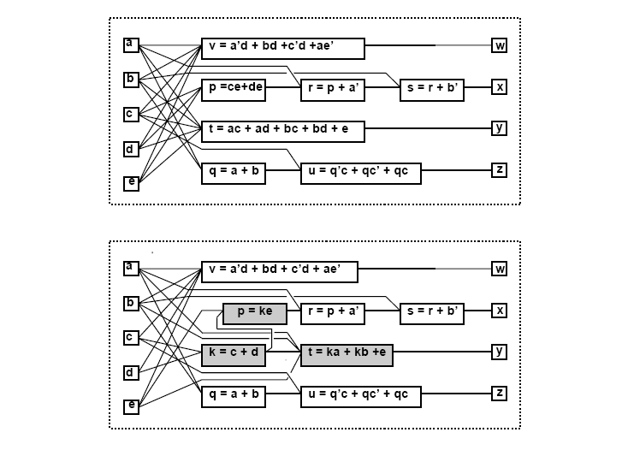
Example
Notes:
Network before and after extraction.

Slide 20
Simplification
Simplify local function
  Use heuristic minimizer like Espresso
  Modify fanin of target node
Example:
  u = q’c + qc’ + qc;
  u = q + c;
Notes:
A function is reduced in complexity by exploiting the properties of its representation.
If the function is represented in a two-level form, then two-level optimization techniques can be applied.
If the support set does not change, the transformation is local. Otherwise, simplification is a global transformation and it corresponds to deleting one (or more) dependencies.

Slide 21
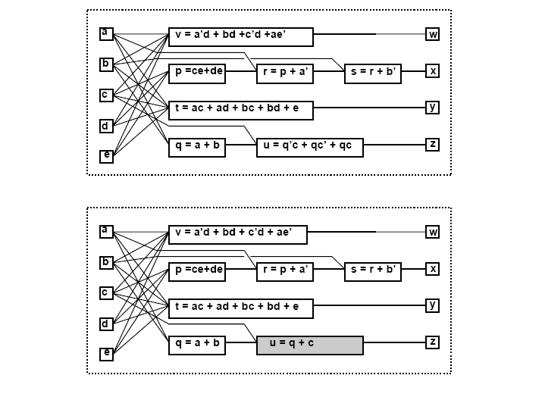
Example
Notes:
Network before and after simplification.

Slide 22
Substitution
Simplify a local function by using an additional input
that was not previously in its support set
Example:
  t = ka + kb + e;
  t = kq + e;
  Because q = a + b is already part of the network
Notes:
A function is reduced in complexity by using an additional input that was not previously
in its support set.
The transformation requires the creation of a dependency, but it may also lead to dropping others.

Slide 23
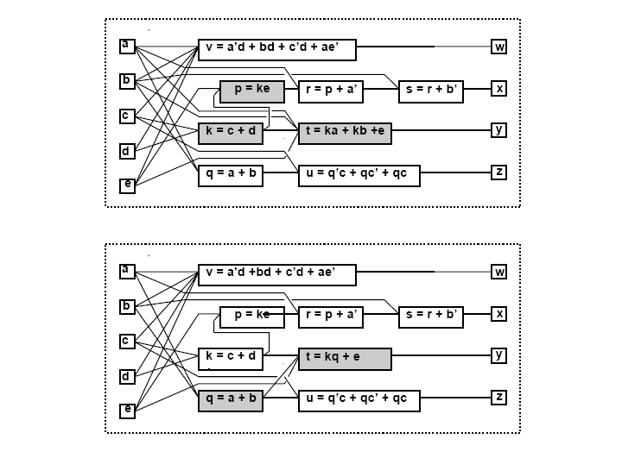
Example
Notes:
Network after extraction and after subsequent substitution.

Slide 24
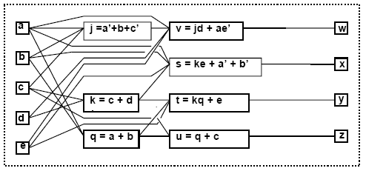
Example – Sequence of transformations
  j = a’ + b + c
  k = c + d
  q = a + b
  s = ke + a’ + b’
  t = kq + e
  u = q + c
  v = jd + ae’
Notes:
Network after a sequence of 5 transformations.

Slide 25
Optimization approaches
Algorithmic approach
  Define an algorithm for each transformation type
  Algorithm is an operator on the network
  Algorithms are sequenced by scripts
Rule-based approach
  Rule data base
    Set of pattern pairs
  Pattern replacement is driven by rules
Most modern tools use the algorithmic approach to synthesis, even though rules are used to address specific issues
Notes:
There are various approaches to optimization.
Heuristic algorithms view transformations as operators acting on a network.
The operators perform transformations until useful one (of the specific kind) are found.
Scripts are used to sequence the transformations.
In the rule-based approach, there is a rule base consisting of pattern pairs.
Each pattern represents a small circuit fragment, and within each pair one pattern is the optimized version of the other.
The optimization system looks for patterns, and replaces them by the locally optimal ones.

Slide 26
Boolean and algebraic methods
Boolean methods for multilevel synthesis
  Exploit properties of Boolean functions
  Use don’t care conditions
  Computationally intensive
Algebraic methods
  Use polynomial abstraction of logic function
  Simpler, faster, weaker
  Widely used
Notes:
The difficulty of the search for creative transformations stems from the degrees of freedom available in manipulating Boolean functions.
Neglecting some Boolean properties can simplify the search for useful transformations, at the expense of some quality of the result.
Different heuristic optimization methods have been proposed, related to different levels of complexity of the underlying models.
The complete Boolean model requires considering all Boolean properties of the local functions while manipulating a logic network.
The dc sets induced by the interconnection must be taken into account.
Logic transformations that use the full Boolean model are called in jargon Boolean transformations.
Brayton and McMullen suggested first to simplify the Boolean model, by expressing the local functions as polynomials, and dropping from consideration some specific assumptions of Boolean algebra.
With the resulting simplified model, the logic network can be optimized by using general properties of polynomial algebra.
This leads to a simpler way of manipulating a network, especially as far as searching for common sub-expressions.
Transformations based on the polynomial model are referred to in jargon as algebraic transformations.
They represent a subset of the Boolean transformations that is simpler and faster to compute.

Slide 27
Example
Boolean substitution:
  Given: h = a + bcd + e; q = a + cd;
  Obtain: h = a + bq + e;
  Because: a + bq +e = a + b(a+cd) + e = a + bcd + e;
Algebraic substitution:
  Given: t = ka + kb + e; q = a + b;
  Obtain: t = kq + e;
  Because: kq = ka + kb;
Notes:
The first example (Boolean) can be explained in terms of the Boolean absorption property a + ab = a.
The second example (Algebraic) requires the knowledge of polynomial algebra only.

Slide 28
Module 2
Objective
  Algebraic model
  Algebraic division
  Kernel theory and applications

Slide 29
Algebraic model
Boolean algebra
  Complement
  Symmetric distribution laws
  Don’t care sets
Algebraic models
  Look at Boolean expressions as polynomials
  Use sum of product forms
    Minimal w.r.to 1-cube containment
  Use polynomial algebra
Notes:
The algebraic model consists of representing the local Boolean functions by algebraic expressions.
Algebraic transformations consists of manipulating the expressions according to the rules of polynomial algebra and by neglecting specific features of Boolean algebra.
Namely, in the (non-Boolean) polynomial algebra we are considering here,
only one distributive law applies and complements are not defined.
As a consequence, some properties like absorption, idempotence, involution and De Morgan's as well as the identities a+a' = 1 ; a a' = 0 cannot be exploited.
Moreover, dc sets are not used.

Slide 30
Algebraic division
Given two algebraic expressions
  An expression divides algebraically the other
  f_{quotient} = f_{dividend} / f_{divisor} when:
  f_{dividend} = f_{divisor} f_{quotient} + f_{remainder}
  f_{divisor} f_{quotient} ≠ 0
  The support of f_{divisor} and f_{quotient} is disjoint
Note that the f_{quotient} and f_{divisor} are interchangeable
Notes:
Algebraic operations are restricted to expressions with disjoint support, to preserve the correspondence of their results with sop forms that are minimal w.r. to single-cube containment.
Indeed this prevents the generation of cubes that are covered by other cubes, as well as universal (void) cubes due to the sum (product) of variables with their complements, which cannot be detected in the algebraic model.
Based on these issues, algebraic division is defined above.

Slide 31
Example
Algebraic division
  f_{dividend} = ac + ad + bc + bd + e
  f_{divisor} = a + b
  Then f_{quotient} = c + d and f_{remainder} = e
  because (a+b) (c+d) + e = f_{dividend}
  and {a,b} ∩ {c,d} = Ø
Non-algebraic division:
  f_{i} = a + bc and f_{j} = a+b
  Then (a+b) (a+c) = f_{i}
  but {a,b} ∩{a,c} ≠ Ø
Notes:
The first example shows an algebraic division: indeed the quotient an divisor have disjoint support.
The second example shows a Boolean division: the result can be explained in terms of Boolean properties ( i.e., a = a + ab + ac ) nad the quotient and divisor have shared support variables.

Slide 32
An algorithm for division
Division can be performed in different way
  Straightforward algorithm by literal sorting
    Simple, quadratic complexity
  Advanced algorithm using sorting
    N-logN complexity
  Typically algebraic division runs fast – small-sized problems
Definitions
  A = set of cubes C^{A}_{j} of the dividend. There are l
  B = set of cubes C^{B}_{i} of the divisor. There are n
  Q = quotient; R = remainder
Notes:
Division can be done in various way. Whereas the use of a heap can reduce complexity to O(n log n), typically division is done in the same way as taught in high school.

Slide 33
An algorithm for division
ALGEBRAIC_DIVISION(A,B)
{
for (i = 1 to n)
{
D = {C^{A}_{j} such that C^{A}_{j} ⊇ C^{B}_{i} };
if (D == Ø) return(Ø,A);
D_{i} = D with variables in sup(C^{B}_{i}) dropped;
if i = 1
Q = D_{i} ;
else
Q = Q ∩ D_{i} ;
}
R = A – Q x B;
return(Q,R);
}
Notes:
This is a simple algorithm for division, which is self-explanatory.
Note that in the algorithm the elements of D_i and Q are sets, but they are considered as single entities as far as the intersection operation is concerned.

Slide 34
Example f_{dividend} = ac+ad+bc+bd+e; f_{divisor} = a+b
A = {ac,ad,bc,bd,e} and B = {a,b}
i = 1:
  C^{B}₁ = a, D = {ac,ad} and D₁ = {c,d}
  Then Q = {c,d}
i = 2 = n:
  C^{B}₂ = b, D = {bc,bd} and D₂ = {c,d}
  Then Q = {c,d} ∩ {c,d} = {c,d}
Result:
  Q = {c,d} and R = {e}
  f_{quotient} = c + d and f_{remainder} = e
Notes:
This simple example is covered in the textbook.

Slide 35
Theorem
Given algebraic expression f_{i} and f_{j}
then f_{i} / f_{j} is empty when either:
  f_{j} contains a variable not in f_{i}
  f_{j} contains a cube whose support is not contained in that of any cube of f_{i}
  f_{j} contains more terms than f_{i}
  The count of any variable in f_{j} is higher than in f_{i}
Notes:
The theorem provides sufficient conditions for a quotient to be empty.
The first two conditions are used in the algorithm for an early exit.
The others can be used as filters, to detect cases where the algorithm does not need to be applied.

Slide 36
Algebraic substitution
Consider expression pairs
Apply division (in any order)
If quotient is not void:
  Evaluate area and delay gain
  Substitute f_{dividend} by j f_{quotient} + f_{remainder}
  where j is the variable corresponding to f_{divisor}
Use filters based on previous theorem to reduce computation
Notes:
Substitution means replacing a sub-expression by a variable associated with an existing vertex of the logic network.
Namely, it targets the reduction in size of an expression f_i by using a variable j ,
not in the support of f_i , that is defined by the equation j = f_j .
Algebraic substitution is a straightforward application of algebraic division.
Indeed, if the algebraic division of f_i by f_j yields a non-void quotient,
then the expression f_i can be rewritten as j quotient + reminder.
The gain of a substitution can be measured (in terms of area and/or delay) by comparing the expressions before and after the substitution. In particular, the variation in terms of literals in a factored-form model is the number of literals of f_j minus one.

Slide 37
Substitution algorithm
SUBSTITUTE(Gn(V,E)){
for (i = 1,2,…,|V|){
for (j = 1,2,…,|V|;j ≠ i){
A = set of cubes of f_{i};
B = set of cubes of f_{j};
if (A,B pass the filter test){
(Q,R) = ALGEBRAIC_DIVISION(A,B);
if (Q ≠ Ø){
f_{quotient} = sum of cubes of Q;
f_{remainder} = sum of cubes of R;
if (substitution is favorable)
f_{i} = j f_{quotient} + f_{remainder};
}
}
}
}
}
Notes:
The search for algebraic substitutions is done by considering all unordered expression pairs, attempting algebraic division and, when a substitution is favorable, replacing the sub-expression corresponding to the divisor by the related variable.
The overall search requires a number of divisions that is quadratic in the size of the logic network.
In practice, filters reduce heavily the number of division attempts to be made, by detecting void quotients early.
In additions a filter (based on the previous theorem) is useful to detect empty quotients.

Slide 38
Extraction
Search for common sub-expressions
  Single-cube extraction
  Multiple-cube extraction (kernel extraction)
Search for appropriate divisors
Extraction is still done using the original kernel theory of Brayton and others [IBM]
Notes:
The extraction of common sub-expressions relies on the search of common divisors of two (or more) expressions.
If one is found, then the divisor can be extracted to represent a new local function of the network, and its corresponding variable can bused to simplify the original expressions.
Extraction boils down to a search for appropriate divisors.
It is done using the kernel theory developed by Brayton and McMullen.

Slide 39
Definitions
Cube-free expression
  Expression that cannot be factored by a cube
    A variable is a cube
    A cube is not cube free
  Example:
    a + bc is cube free
    abc and ab + ac are not
Kernel of an expression
  Cube-free quotient of the expression divided by a cube,
  called co-kernel
  Note that since divisors and quotients are interchangeable, kernels are just a subset of divisors
Kernel set of an expression f is denoted by K(f)
Notes:
A cube-free expression is an expression which cannot be factored by a cube.
A kernel of an expression is a cube-free quotient of the expression divided by a cube, which is called co-kernel of the expression.
Note that single-cube quotients are not kernels, because they can be factored as products of the cube itself times 1, and hence they are not cube-free.
Consequently, single-cube expressions have no kernels.
The set of kernels of an expression f is denoted by K(f).
When an expression is cube-free, it is considered to be a kernel of itself, its co-kernel being cube 1. This kernel and this co-kernel are called trivial.

Slide 40
Example
f = ace + bce + de + g
Trivial kernel search:
  Divide f by a. Get ce. Not cube free
  Divide f by b. Get ce. Not cube free
  Divide f by c. Get ae + be. Not cube free
  Divide f by ce. Get a + b. Cube free. KERNEL!
  Divide f by d. Get e. Not cube free
  Divide f by e. Get ac + bc + d. Cube free. KERNEL!
  Divide f by g. Get 1. Not cube free
  Divide f by 1. Get ace + bce + de + g. Cube free. KERNEL!
K(f) ={ (a+b); (ac+bc+d); (ace+bce+de+g) }
CoK(f) = { ce, e, 1}
Notes:
This example shows a trivial kernel search.
The function is divided by variables, variable pairs, etc.
In this example, only some relevant divisions are shown.
Details are reported in the textbook.

Slide 41
Theorem
Brayton and McMullen
Two expressions f_{a} and f_{b} have a common multiple-cube divisor f_{d} if and only if
  There exist kernels k_{a} in K(f_{a}) and k_{b} in K(f_{b}) such that
  f_{d} is the sum of two (or more) cubes in k_{a} ∩ k_{b}
Consequences
  If kernel intersection is void, then the search for common sub-expression can be dropped
  If an expression has no kernels, it can be dropped from consideration
  The kernel intersection is the basis for constructing the expression to extract
Notes:
The set of kernels of an expression provides essential information for detecting common sub-expressions with multiple-cubes.
The kernels are sum of monomials (cubes) that form the building blocks for constructing the common sub-expression to be extracted, when this is possible.
The relations between kernel sets and common multiple-cube expressions is stated precisely by Brayton-McMullen's theorem.
There are important consequences of this theorem.
First, when two expressions have either no kernel intersections or only single-cube kernel intersections, then they cannot have any multiple-cube common sub-expression.
Thus, when an expression has an empty kernel set, then no multiple-cube common sub-expression can be extracted, and the corresponding vertex can be dropped from consideration.
Second, multiple-cube kernel intersections are common multiple-cube divisors of the expressions corresponding to the kernels.

Slide 42
Example
f_{x} = ace + bce + de + g
f_{y} = ad + bd + cde + ge
f_{z} = abc
K(f_{x}) = { (a+b); (ac+bc+d); (ace+bce+de+g) }
K(f_{y}) = { (a+b+ce); (cd+g); (ad+bd+cde+ge) }
The kernel set of f_{z} is empty
Select intersection (a+b)
  f_{w} = a + b
  f_{x}= wce + de + g
  f_{y} = wd + cde + ge
  f_{z} = abc
Notes:
In this example, the first two expression have kernels.
There is a kernel intersection (i.e., a + b ) that can be extracted.

Slide 43
Kernel set computation
Naïve method
  Divide function by the elements of the power set of its support set
  Weed out non cube-free quotients
Smart way
  Use recursion
    Kernels of kernels are kernels
  Exploit commutativity of multiplication
Notes:
Kernels can be obtained by dividing an expression by the power set of the variables in its support set, and by weeding out the quotients that are not cube-free.
A kernel of a kernel of an expression is also a kernel of the original expression, its overall co-kernel being the product of the corresponding co-kernels.
This allows us to define a recursive algorithm for kernel search.

Slide 44
Recursive algorithm
The recursive algorithm is the first one proposed for kernel computation and still outperforms others
It will be explained in two steps
  R_KERNELS (with no pointer) to understand the concept
  KERNELS (Complete algorithm)
The algorithms use a subroutine
  CUBES( f,C ) which returns the cubes of f whose literals include those of cube C
  Example: f = ace +bce + de + g -- CUBES(f, ce) = ace + bce
Notes:
We consider first an intermediate recursive algorithm, that exploits only recursion, for the sake of explanation.
The complete algorithm is described later.
The algorithms require a subroutine.
Let CUBES(f,x) be a function that returns the set of cubes of f whose support includes variable x and let CUBES(f,C) return the set of cubes of f whose support includes C .

Slide 45
Simple recursive algorithm
R_KERNELS(f){
K = Ø;
foreach variable x ε sup(f){
if (|CUBES(f,x)| ≥ 2) {
C = maximal cube containing x, s.t. CUBES(f,C) = CUBES(f,x);
K = K U R_KERNELS(f / C);
}
}
K = K U f;
return(K);
}
Notes:
This algorithm is described in detail in the textbook.

Slide 46
Analysis
The recursive algorithm does some redundant computation in the recursion
  Example
    Divide by a and then by b
    Divide by b and then by a
  Obtain duplicate kernels
Improvement
  Exploit commutativity of multiplication
  Keep a pointer to the literals used so far
Notes:
The recursive algorithm can be improved by using commutativity of multiplication.
Indeed, we can order the variables so that duplicate kernels are not computed.
This leads to a more effective procedure, which is achieved by using a pointer in the recursive call to the variables used so far.

Slide 47
Recursive kernel computation
KERNELS(f,j){
K = Ø;
for i = j to n {
if (|CUBES(f,x_{i})| ≥ 2) {
C = maximal cube containing x_{i},
s.t. CUBES(f,C) = CUBES(f,x_{i});
if (C has no variable x_{k} , k < i )
K = K U KERNELS( f / C ,i+1);
}
}
K = K U f;
return(K);
}
Notes:
This algorithm is fully described in the textbook.

Slide 48
Example
f = ace + bce+ de + g
Literals a and b. No action required
Literal c. Select cube ce
  Recursive call with argument f/ce= a+b. Pointer j = 3+1
  Call considers variables {d,e,g}. No kernel.
  Adds a + b to the kernel set at the last step.
Literal d. No action required.
Literal e. Select cube e
  Recursive call with argument f/e = ac + bc + d. Pointer j = 5+1
  Call considers variables {g}. No Kernel
  Adds ac+bc+d to the kernel set at the last step of recursion
Literal g. No action required
Add f = ace + bce + de + g to kernel set
K(f) = { (ace+bce+de+g),(ac+bc+d),(a+b) }
Notes:
Let us consider expression f= ace + bce + de + g . It is cube-free and so no pre-processing is required. Let us consider again the variables in lexicographic order. No action is taken in conjunction with the first two variables, because both are contained in one cube only.
Let i=3 .
The third variable, c , is in the support of two cubes. The largest subset C of support variables, containing c and contained in the support set of both ace and bce is again {c,e} .The recursive call of KERNELS has as arguments expression (ace + bce + de + g) / ce = a+b and pointer j=3+1 . The call considers then variables { d, e, g} but it does not find any additional kernel. Nevertheless, it adds a+b to the kernel set at the last step.
The fourth variable is then considered, namely d . Since d is in the support of only one cube of f , no action is taken.
Let then i=5 .
The fifth variable, e , is in the support of three cubes of f . No other variable in sup(f) is in the support of the same cubes. A recursive call is done with arguments ac+bc+d and pointer j=5+1 . In the recursion, only the sixth variable, g , is considered and no kernel is discovered. Before returning from the recursion, ac+bc+d is added to the kernel set.
Eventually the sixth variable, g is considered. Since it is in the support of only one cube of f , no action is taken.
The last step adds f= ace + bce + de + g to the kernel set. The algorithm returns: K = { (ace + bce + de + g), (ac+bc+d), (a+b)} .

Slide 49
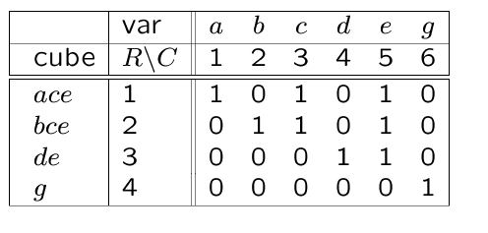
Matrix representation of kernels
f = ace + bce + de +g
Incidence matrix
  Cubes vs. variables
Rectangle
  Subset of rows/columns with all entries equal to 1
Prime rectangle
  Rectangle not included in another rectangle
A co-kernel is a prime rectangle with at least two rows
Example:
  Prime rectangle ({1,2},{3,5})
  Co-kernel ce
Notes:
Kernels can be visualized using a cube/variable incidence matrix.
Let a rectangle by a subset or rows and columns with all entries equal to 1.
Then a co-kernel is a rectangle with two properties:
Non trivial: at least two rows
Prime: not contained in another rectangle.
Matrices help visualizing the process, but matrix-oriented methods are not as efficient as the recursive algorithm.

Slide 50
Application of kernel methods
Single cube extraction
  Extract one cube from two (or more) sub-expressions [Brayton]
Kernel extraction
  Extract a multiple-cube expression [Brayton]]
Kernel-based decomposition
Notes:
Kernels and kernel theory can be applied to solving several problems.

Slide 51
Single-cube extraction
Form an auxiliary expression, which is the union (sum) of all local expression
Find the largest co-kernel
  Corresponding kernel must belong to two (or more) different expressions
  Use additional variables to tag the expressions
Extract chosen co-kernel
The problem can be well visualized by a matrix representation and the extraction of a prime rectangle
Notes:
We are interested in extracting cubes (one at a time) that are common divisors of two (or more) expressions, i.e. that are intersections of two (or more) cubes in different expressions.
Obviously, such cubes should have two or more variables to be relevant for extraction.
The systematic search of cube intersections is based on the following observation.
The set of non-trivial co-kernels of an algebraic expression in sop form (i.e. sum of cubes)
corresponds to the intersections of two or more of its cubes.
Equivalently, the co-kernels are identified by the intersections of the support sets of the cubes.
Then, we can construct an auxiliary expression, which is the sum of all local expressions.
Co-kernels in the auxiliary expression denote the cubes that can be extracted.
This can be achieved with the recursive (or any other) kernel computation algorithm.

Slide 52
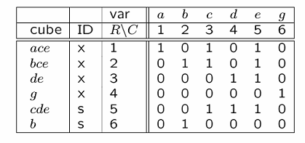
Example
Expressions:
  f_{x} = ace + bce + de + g
  f_{s} = cde + b
Auxiliary function:
  f_{aux} = ace + bce + de + g + cde + b
Tagging:
  f_{aux} = xace + xbce + xde + xg + scde + sb
Co-kernel: ce
After cube extraction
  f_{z} = ce
  f_{x} = z (a+b) + de + g
  f_{s} = zd + b
Notes:
Given expressions f_x = ace + bce + de + g and f_s = cde + b , the auxiliary expression is: f_{aux} = a_x ace + a_x bce + a_x de + a_xg + a_s cde + a_s b .
The co-kernels are { ce , de, b, a_x ce , a_x e, a_x, a_s, 1 .
Relevant cube intersections are those denoted by co-kernels ce or de .

Slide 53
Multiple-cube extraction
We need a cube/kernel matrix
  Relabel cubes by new variables
  Kernels are now cubes in these new variables
Find a prime rectangle
Equivalently, find a co-kernel of the auxiliary expression that is the sum of the relabeled expressions
Notes:
A way for computing the kernel intersections is based on computing the co-kernels of an appropriate auxiliary function, as in the case of cube extraction.
The difference, with respect to cube extraction, is the following.
In cube extraction, we were looking for cube pairs with intersecting support in a sop form.
For kernel intersections we are looking for intersections of the elements of the kernels.
These elements are cubes that are considered as atomic elements as far as their intersection is concerned, even though they are set themselves. For this reason, we can rename each cube by an unique identifier, i.e. a new variable. A kernel is then represented by a set of these new variables.

Slide 54
Example
f = ace + bce
  K(f) = {(a+b)}
g = ae + be + d
  K(g) = {(a+b); (ae +be+d)}
Relabeling: x_{a}=a; x_{b}=b; x_{ae}=ae; x_{be}=be; x_{d}=d
  Then K(f) ={{x_{a},x_{b}}} and K(g) = {{x_{a},x_{b}},{x_{ae},x_{be},x_{d}}}
  f_{aux} = f x_{a} x_{b} + g x_{a} x_{b} + g x_{ae} x_{be} x_{d}
  CoK(f_{aux}) = x_{a} x_{b}
Go back to original variables
  Extract (a + b) from f and g
Notes:
The first co-kernel denotes the set { x_a, x_b} corresponding to the kernel intersection a+b .
The other co-kernels do not represent multiple-cube common sub-expressions, and thus they are not useful for extraction.

Slide 55
Double-cube extraction
Restrict extraction to:
  Double-cube kernels
  Single-cube kernels with two literals
  Consider concurrently their complements
Properties
  These small kernels can be computed efficiently
  Circuit testability is preserved
  Method is very efficient in reducing network
Notes:
Double-cube extraction is a simple and effective method.
It restricts the extractions to kernels that have 2 cubes, and to single-cube kernels with two literals.
The rationale is that these kernels are very common, and can be computed efficiently.
Thus the strategy is to concentrate on simple and common elements to extract.

Slide 56
Kernel-based decomposition
There are many different ways of performing decomposition
  Several classic approaches (e.g., Ashenhurst & Curtis)
Algebraic decomposition
  Find good algebraic divisors
  Use kernels and decompose recursively
Notes:
The decomposition of logic functions has been object of intensive investigation, and many methods are available.
As far as algebraic methods are concerned, decomposition can be done by searching appropriate divisors, and by dividing the expression by these divisors.
In particular, kernels can be used.

Slide 57
Example
Decompose f = ace + bce + de + g
Select kernel ac + bc + d
Decompose as: f = te + g; t = ac + bc + d
Recur on quotient t
Select kernel a + b
Decompose t = sc + d; s = a + b; f = te + g;
Notes:
In this simple example, detailed in the textbook, the expression is recursively dived by its kernels.

Slide 58
Summary algebraic methods
Algebraic methods abstract functions as polynomials
  Polynomial division
Methods are fast and widely applicable
Algebraic methods miss opportunities for optimization
  As compared to Boolean methods
Algebraic transformations are reversible
  Ease transformations back and forward to trade off area and speed
Notes:
In summary, algebraic methods are most often used, because they are simple and fast.
Thus they are applicable to large networks. Moreover, it is always possible to reverse algebraic transformations, and thus these are useful within logic synthesis systems that make trade offs, like area for delay, and require some backtracking.

